Slide 1
An Introduction to Down Syndrome
Tom Connor
Educational Psychology Service

Slide 2
Down’s Syndrome
History
Incidence
Causes
Types of Down’s syndrome
Identification
Physical Features

Slide 3
Down’s Syndrome
What is it? (group)
What do we need to think about in a secondary school setting?

Slide 4
History
1866 - Discovered by John Langdon Down
1959 - Professor Jerome Lejeune-proved chromosomal irregularity
Notes:
1866 First described by John Langdon Down who published a description
1959 Professor Jerome Lejeune proved it to be a chromosomal irregularity.
3 rather than the usual 2 chromosomes for the pair no 21;
47 not 46 chromosomes in each cell.
The extra chromosome results in the physical characteristics and course of development.

Slide 5
Incidence
1 / 1,000 is born with Down’s Syndrome each year
600 births per year
In the UK – approximately 60,000 people have Down’s syndrome

Slide 6
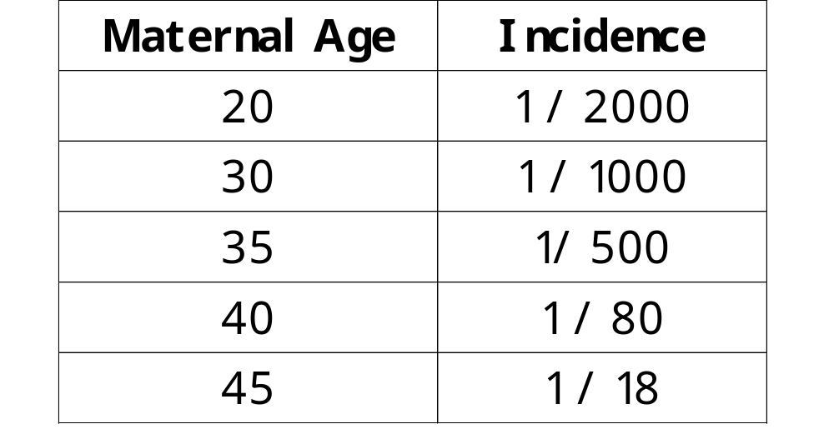
Notes:
Cause currently unknown, but research is advancing on the extra 21st chromosome.
Associated with mothers over 35, but most DS births are to younger mothers who are more fertile.

Slide 7
Conception
Down’s syndrome - cells do not divide properly
Result:
  Trisomy 21,
  Translocation,
  Mosaicism

Slide 8
Trisomy 21 (94%)
Cause
  faulty chromosome division in early pregnancy
Result
  3 chromosome 21s (not 2), in every cell

Slide 9
Translocation (3%)
Chromosome division:
  part of chromosome 21 breaks off & attaches to another chromosome
This new pattern is then found in every cell

Slide 10
Mosaicism
Least common form - 2%
Most cells contain 46 chromosomes (normal amount)
Some cells have 47 chromosomes

Slide 11
Identification
Before birth - screening and diagnostic tests
After birth - physical appearance
Every child is unique. Every child with Down Syndrome is equally unique.

Slide 12
Physical Features
Muscle tone
  Low muscle tone - unusual suppleness in early years
Hands
  Broader, shorter fingers

Slide 13
Physical Features
Eyes
  ‘Slanted’ appearance - extra folds of skin on inner corner of eye
Mouth
  Smaller oral cavity - causes tongue to protrude

Slide 14
Visual Impairment
Astigmatisms (cornea oblong not spherical)
Squints
Cataracts (cloudiness of the lens)
60-70% will need glasses

Slide 15
Hearing Impairment
Conductive hearing loss (glue ear)
  Temporary
  50% of children with DS
Sensory-neural hearing loss
  Permanent
  20% of children with DS
Multi-Sensory Impairment?

Slide 16
Heart Disorders
Found in about 50% of children with DS
Range from slight murmurs and monitoring, to need for corrective surgery

Slide 17
Underactive Thyroid
Found in 15% children with DS
Affects ability to regulate body temperature
Weight gain

Slide 18
Gastrointestinal Problems
Feeding & digestion difficulties
Chronic constipation
Celiac disease (wheat sensitivity)
Reflux (regurgitation of food from the stomach)

Slide 19
Skeletal Problems
Slack ligaments connecting joints
Greater range of limb movement than normal population
Wide gait & difficulties in balance

Slide 20
Hypertonia (Low Muscle Tone)
delayed motor milestones
clumsiness
Less able to explore environment:
  difficulty reaching
  grasping
  initiating social interactions

Slide 21
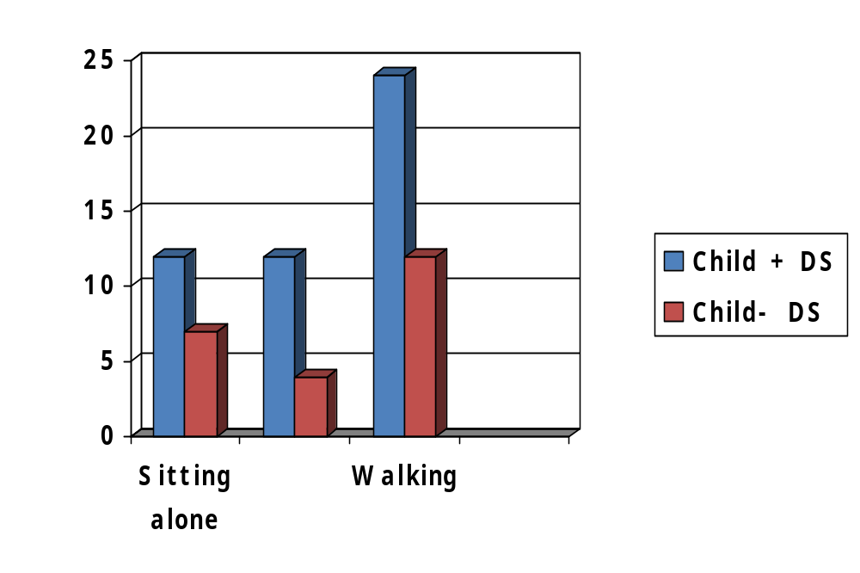
Motor Development
Often Delayed
Motor difficulties
impact upon
education

Slide 22
Educational Implications
Children with DS not just delayed BUT different
Need a different, not diluted curriculum
Thoughts so far… Implications? (groups)

Slide 23
Language
Receptive language difficulties
  delay in understanding/processing speech
  poor auditory memory (remembering verbal information)
  difficulties in attention
  difficulties in sequencing

Slide 24
Language
Expressive language difficulties
  Articulation problems
  Word finding difficulties
Notes:
Associated with behaviour difficulties, ‘stubbornness’ all because pupil is confused by the situation.
Use the language of instruction – short words, short sentences, repetition
Get subject teachers to talk on two levels
Don’t always use the LSA as the interpreter
Implications for school and class ‘rules’.
Can be very confusing when each subject teacher has a different method for eg collecting work, asking for help etc. DS pupil can’t switch rules
Suggest getting teachers together and discussing the ‘rules’
E.g. How do you get worked marked? Lining up; putting up hand; peer marking ?

Slide 25
Language
Language difficulties may lead to
  Confusion at situation
  Challenging behaviour
  DS Pupils need visual learning support.
Notes:
Visual timetables
Notices with pictures around the school
Arrows for directions around the school

Slide 26
Motor Skills
Poor gross & fine motor skills impact on:
  mobility
  writing
  Self-care
  … Link also to Executive Functioning, Working Memory and Organisation
Notes:
Support in practical situations needed.
May need to find alternatives to expecting DS child to produce lots of written work
Can use LSA to write on stickers, and pupil pulls off the stickers and sticks them in order

Slide 27
Poor short term memory
Children with DS have difficulties with
  attention (or attending)
  consolidation of new material
  retention
  sequencing
Notes:
Use prompts, reminders, small group instruction, notices up
Try not to say ‘But they were told …..!!’
Make use of pupil's word reading skills – write things down for him
Use visual or reading prompts as a reminder of the task
Try to teach self-regulation by a series of prompts

Slide 28
Websites
Www.down-syndrome.org.uk
www.dsa.uk
www.downsed.org
www.dsscotland.org.uk/
www.cafamily.org.uk

Slide 29

Iceberg model – understanding individual behaviour
The behaviour that we see is just the tip of the iceberg….we need to look below the surface to understand what the behaviour is telling us
Notes:
The author Philip Whitaker suggests thinking of behaviour as an iceberg: the behaviour you are actually seeing is the tip of the iceberg but there's a lot more going on under the surface (Whitaker, 2001). People with an ASD can't always express their feelings through facial expressions, body language or speech. Instead, they may be expressed through other behaviours. Your child might be trying to tell you they are tired, stressed, annoyed by something that happened earlier, or in need of some time alone.

Slide 30
Managing behaviour: ICEBERG analysis
Specific behaviour
“WHAT?”
Possible reason /
Communicative function
“WHY?”
The Iceberg Metaphor
(Schopler 1995)

Slide 31
Managing behaviour: ICEBERG analysis
e.g. angry outbursts
Specific behaviour
“WHAT?”
Possible reason /
Communicative function
“WHY?”
e.g. poor understanding of social rules
Unaware of others’ feeling
Hypo-sensitive to touch
Frustration over communication skills
Response to stressor (e.g. noise, smell)
The Iceberg Metaphor
(Schopler 1995)

